Slide 1



Critical Review of Literature
Centre for Learning and Study Support (CLaSS)
Bev Hancock-Smith

Slide 2
Overview
What is a literature review?
A 4-step approach to reviewing literature
Writing your review

Slide 3

The Literature Review and you
All projects will involve some form of literature review
  Development, Research and Hybrid
For ‘Research’ projects this is a major component.

Slide 4
What is a Literature Review?
DEFINTION AND PURPOSE

Slide 5
“Literature review” – what is it?
“The comprehensive study and interpretation of literature that relates to a particular topic”
(Aveyard, 2010, p.5)
It is used to Frame your own research and to show the reader that you …
  understand what has already been done on your topic
  understand how it has been researched
  recognise the key issues
  are familiar with different points of view
  can integrate all the information in a coherent and organised way

Slide 6

A literature review...
Allows your own work to be ‘situated’ in relation to other research
i.e. where is it on a map?
Identifies and critically evaluates existing knowledge on your specific topic
i.e. zoom in on your area

Slide 7
Fit with Structure (research)
Likely to look like:
Introduction or background
Literature review
Research methods used
Findings or results
Analysis and discussion
Recommendations / conclusions
A few key, contextual references here
Literature about topic here
Possible references on methods
Link back to literature

Slide 8
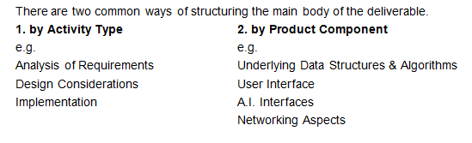
Fit with Structure (Development)
Literature Review here
Link back to lit review
Literature for each aspect
See “On Writing the Final Deliverable” in Blackboard

Slide 9
A 4-StEP APPROACH TO THE LITERATURE REVIEW

Slide 10
1. Scope
2. Search
3. Read
4. Write

Slide 11
Scope
1
Start with your title or question
Break it down into key areas
Choose keywords that express those ideas
Decide on the parameters of your research – what are your aims/objectives and what do you need to find out?
Your literature review should be organised in response to the focus of your research – your aims, question or argument
See https://libguides.library.dmu.ac.uk/class/disstoolkit, Managing Your Work section

Slide 12

Search
2
Decide on Keywords, phrases and core concepts
Work out the best, most trusted sources of information.
Journal articles from high quality peer-reviewed journals will usually form the core your ‘literature’
Search should be systematic i.e. planned and documented
See https://libguides.library.dmu.ac.uk/class/disstoolkit, Researching section

Slide 13

Read
3
At first, read for the gist of the literature – look at abstracts, introduction and conclusion, opening sentences in paragraphs
HOW is the information or opinion relevant to your work? STOP if it isn’t relevant and go on to the next one.
Consider the validity of the methods, argument and conclusions. Do they stand up to scrutiny?
Compare/contrast one article with the next. What are the common threads and themes?
See https://libguides.library.dmu.ac.uk/class/disstoolkit, Reading section

Slide 14
Taking a critical approach to the topics in your literature review
Source ( article, chapter, website, etc) | Key ideas, or information | How does it link to other ideas? ( Does it support or contradict other views or information) | How does it support your overall argument?
See https://libguides.library.dmu.ac.uk/class/disstoolkit, Reading section

Slide 15
Turning critical reading into critical writing
Analysis
Breaking an argument down into its constituent parts
Evaluation
Making a judgement as to the validity of the argument. Are the conclusions justified?
Synthesis
Making connections between the parts identified in an analysis
THINKING
Reading
Writing

Slide 16

Themes
“These things seem relevant to the problem I’m looking at”
“My own experience tells me that this is important...
...where is this reflected in the reading?”
“This issue keeps coming up again and again in the things I’m reading...”
Consider the question you are trying to answer – what evidence can you find?
Read widely to spot patterns
Reflect on your own knowledge and consider the sources of your reading
What is important?

Slide 17

Write
4
You should have an idea of the key themes of your review before you start writing
You should have a clear argument relating the literature you have reviewed to your own research question
You should have a plan for how to structure your review
See https://libguides.library.dmu.ac.uk/class/disstoolkit, Writing section

Slide 18
Questions to ask yourself while writing
Why am I writing this? How does it fit in and will the reader understand?
Have I included too much detail or too little?
Am I connecting the different ideas in my writing using appropriate links to help my reader?
Have I presented evidence and argument to support my views?
Am I putting this in the right place?

Slide 19
How to organise and structure the literature review

Slide 20
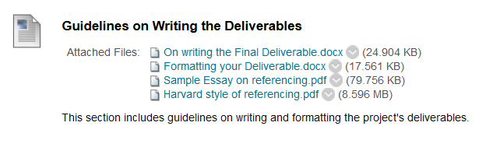
What does it look like?
Academic writing in a report style
Section and sub-sections
  Exploring themes
  Drawing conclusions
  In paragraphs
See your guidance on Blackboard

Slide 21
Ways to organise your literature review
Present a discussion of the major writings regarded as significant in your area of study and show how they relate to your topic
Divide the review into sections representing the main themes for your topic. Show how the literature has influenced your choice of research topic and what you plan to do
Use your discussion of the literature to show an historical or developmental context

Slide 22
Structuring a literature review
Introduction
  Signpost the content
  Central ideas
  Purpose of the review
Main part
  Sections in logical order (one topic or theme per section)
  Develop an argument or point of view
  Show that you know where you’re going
Conclusions
  Summarise the key points
  Draw conclusions (only possible if you’ve evaluated what you’ve read!)

Slide 23
Identify a topic
Preliminary reading
Develop your research question
Keywords and sources for literature search
Systematic literature search
SCOPE
SEARCH
Relevance for your research
Conclusions
Summary: The Literature Review Process
Organising results
Reading for review
Analysis of argument
Evaluation of evidence
Emerging themes
Structure of review
WRITE
READ

Slide 24


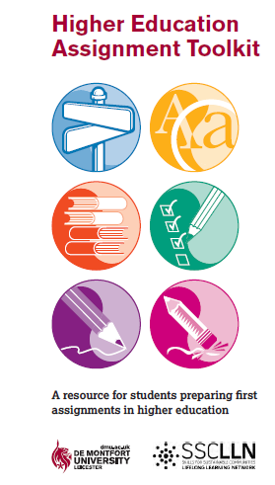
Centre for Learning and Study Support
Enhancing academic practice, writing development and professional skills
Tutorials and Drop-in
Workshops
Workshops run regularly: Keep an eye out on blackboard and MyDMU to see our upcoming sessions
To sign up go the library what’s on page: www.library.dmu.ac.uk/Home/Calendar
Book a 30 minute one-to-one appointment to discuss any aspect of your study or work: visit the Library “What’s on?” page to book.
Just a quick question? Drop in every Monday, Wednesday, Friday 2-3pm or Tuesday, Thursday 5-6pm in the LDZ Kimberlin library where CLaSS will be waiting to answer your question!
Guides
HEAT, “Focus On” and more…
To view our online resources go to: www.library.dmu.ac.uk/link/CLASS
To help fit the pieces of your study together visit: www.library.dmu.ac.uk/link/CLASS

